Slide 1
Deep Learning In White Blood Cells Classification
Deep learning approach for classification of White Blood Cells Images
Team members: Francisco Ortiz, Mudiha Wazirali , Vi Le
Instructor: Dr. Benjamin Soibam

Slide 2
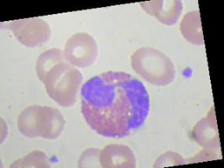

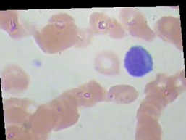

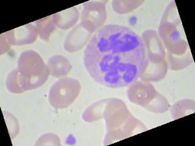

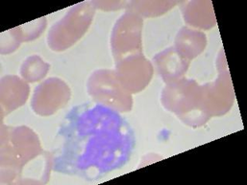

WHITE BLOOD CELLS CLASSIFICATION
CLASS-BALANCED DATASET

Slide 3
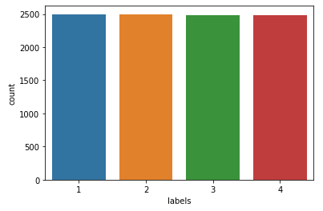
CLASS BALANCE
CLASS-BALANCED DATASET
Count of images in each class
Train Dataset
Test Dataset
Train Dataset Total
Test Dataset Total
9957
2487
Number of images in each class almost equal so there is no class imbalance issue
Data source: https://www.kaggle.com/paultimothymooney/blood-cells
Folder name: dataset2-master

Slide 4

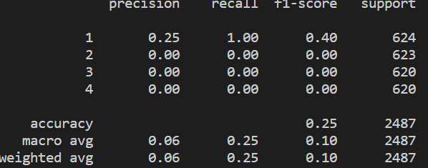
FEATURE BASED MODEL - RANDOM FOREST
Worked well with a random generated dataset
Prediction accuracies when using HOG data
Using HOG data under-performed when comparing to full-featured data
Accuracy 25%

Slide 5
DEEP LEARNING MODELS
CNN 1
CNN2
Added Layers Using Hyperparameter Optimization
CNN1
CNN2
AlexNet
InceptionV3

Slide 6
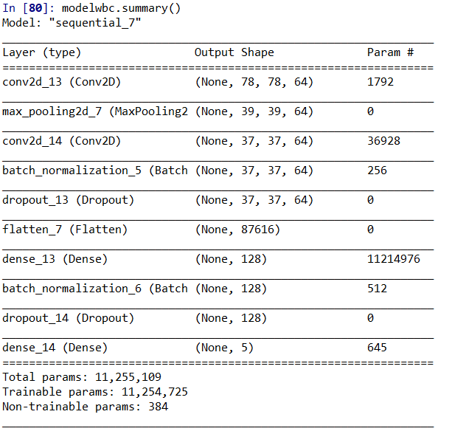
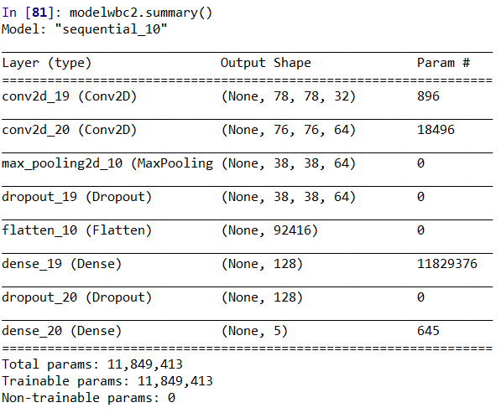
CNN MODEL 1
CNN MODEL 2

Slide 7
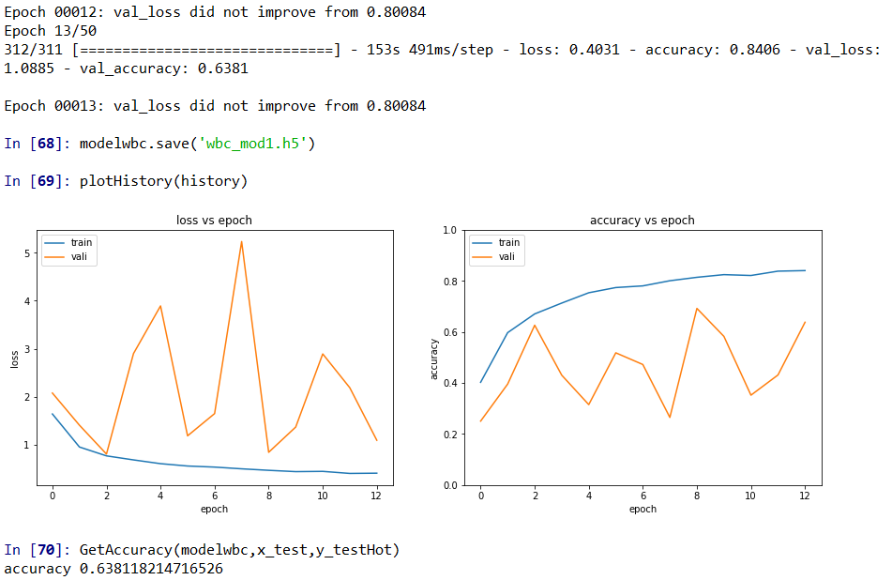
CNN MODEL 1 -RESULTS
Optimizer: Adadelta
The first CNN model has a prediction accuracy of 0.64

Slide 8
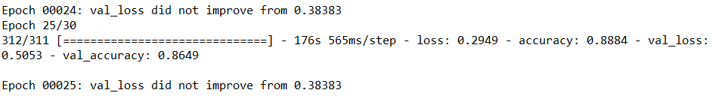
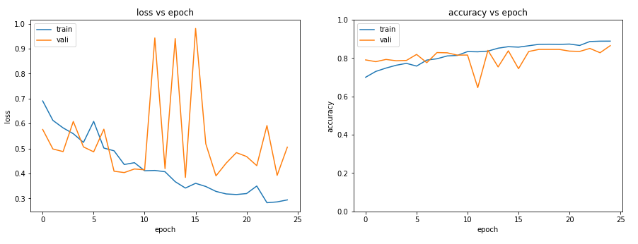

CNN MODEL 2 -RESULTS
The second CNN model has a prediction accuracy of 0.86
There is a significant improvement on prediction accuracy comparing to the first model
Optimizer: Adadelta

Slide 9
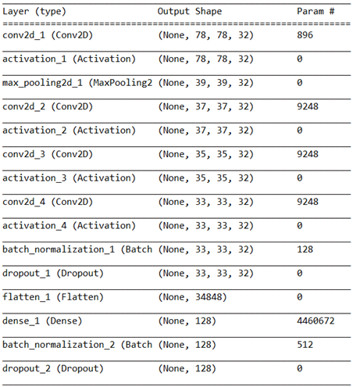
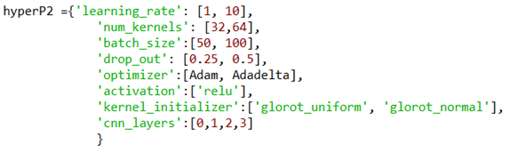
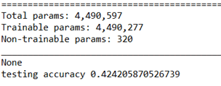
HYPERPARAMETER OPTIMIZATION
MODEL 1
250 Permutations
10% Random Selection
3 additional Convolutional layers, 32 number of kernels
Optimizer = Adam, lr= 0.001

Slide 10
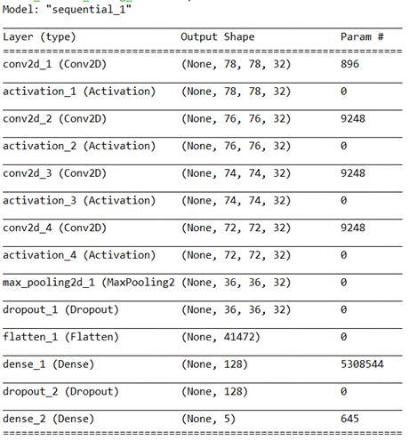
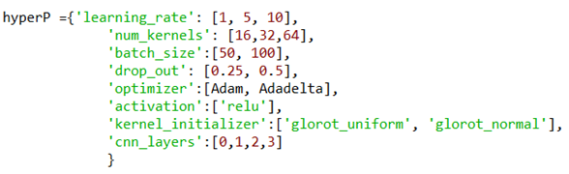
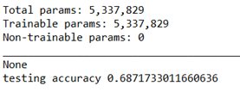
HYPERPARAMETER OPTIMIZATION
MODEL 2
570 Permutations
10% Random Selection
3 additional Convolutional layers, 32 number of kernels
Optimizer: Adadelta, lr= 5

Slide 11
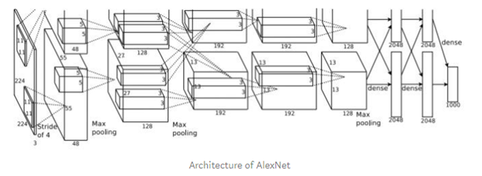
ALEXNET - ARCHITECTURE
8 Layer Convolutional Neural Network Architecture
Consists of Convolutional layers, Activation layers, Max Pooling layers and Dense layers
5 convolutional layers
3 max pooling layers
3 dense layers
one output dense-softmax layer
Training
Not Pre-Trained in Keras with ImageNet
Pre-Trained weights from Tensorflow do not have a history of high accuracy
Trained itself to find the best model validation accuracy.
https://medium.com/datadriveninvestor/cnn-architecture-series-alexnet-with-implementation-part-ii-7f7afa2ac66a

Slide 12
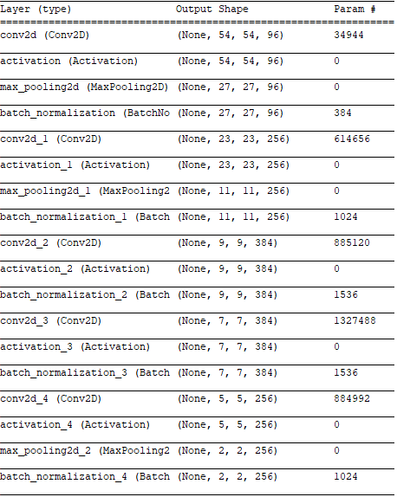
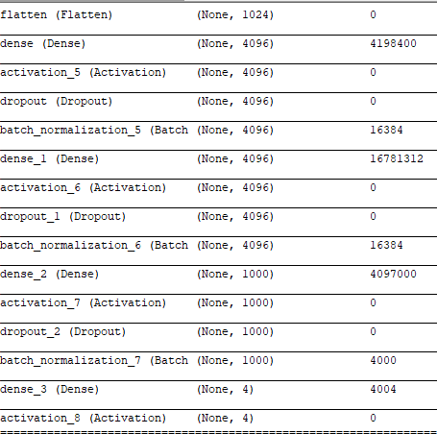

AlexNet MODEL

Slide 13
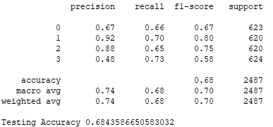
AlexNet MODEL

Slide 14
PRE-TRAINED MODELS
A pre-trained model was trained on a large benchmark dataset to solve a problem similar to the one that we want to solve
InceptionV3

Slide 15
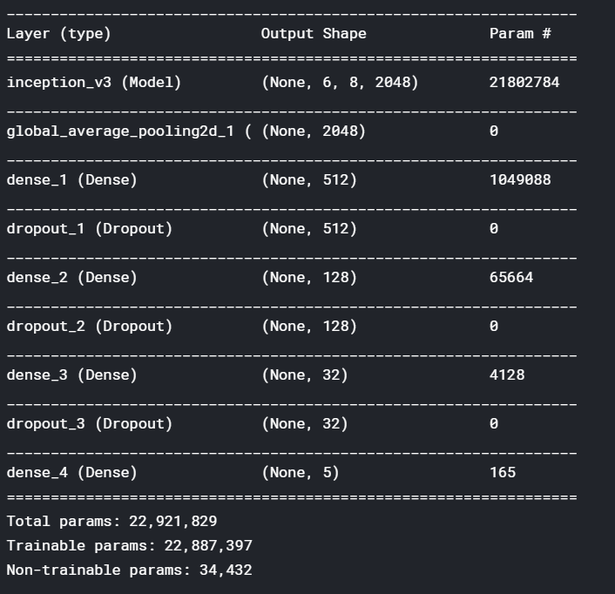
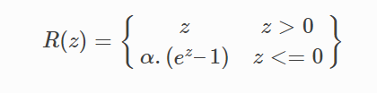
INCEPTION V3 - ARCHITECTURE
Based on InceptionV3 with 48 layers
Added 3 fully connected layers with ELU activation function

Slide 16
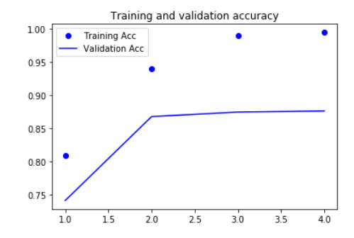
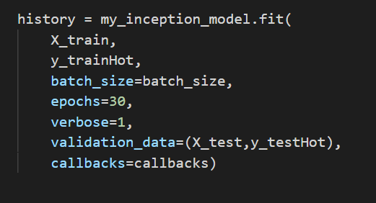
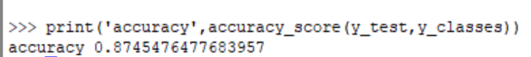
INCEPTION V3
Train the model using white cell images only
accuracy
epoch

Slide 17
MODEL SELECTION
Model | Accuracy | Result
Random Forest | 25%
CNN1 | 64%
CNN1 - added layers using Hyperparameter Optimization | 42%
CNN2 | 86.5%
CNN2 - added layers using Hyperparameter Optimization | 69%
AlexNet | 68.4%
InceptionV3 | 87.5% | Best model

Slide 18
FUTURE PLAN
Import the result of a feature based model to a deep learning model
Try different sets of hyperparameters (e.g: Brute Force)
Apply our selected model to different datasets to see if the model is applicable

Slide 19
REFERENCE
Chollet François. Deep Learning with Python. Manning Publications Co., 2018
Hub, Git. “Usage of Optimizers.” Keras Documentation, 2019, keras.io/optimizers
Mooney, Paul. “Blood Cell Images.” Kaggle, 21 Apr. 2018, https://www.kaggle.com/paultimothymooney/blood-cells

